Slide 1
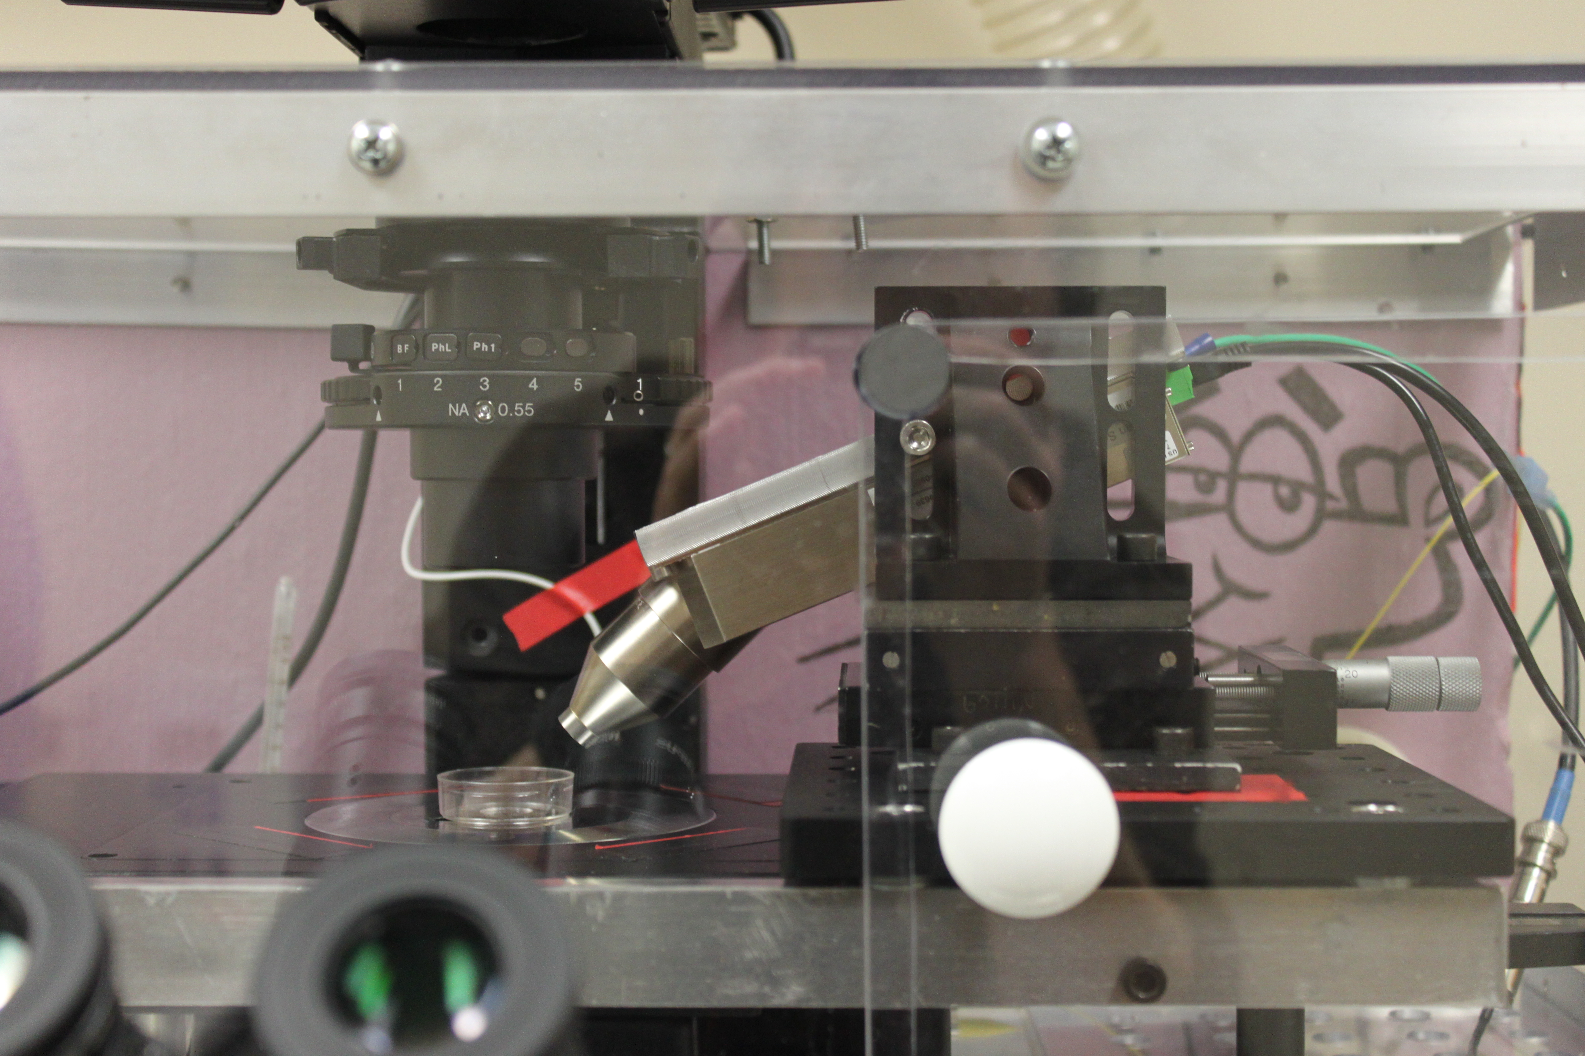
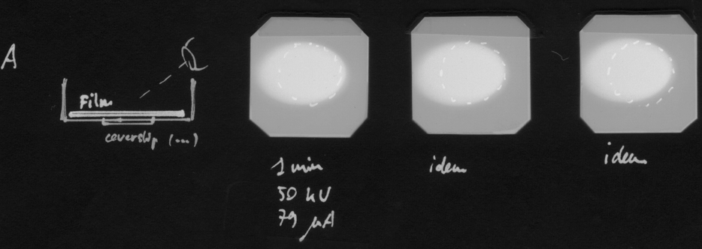
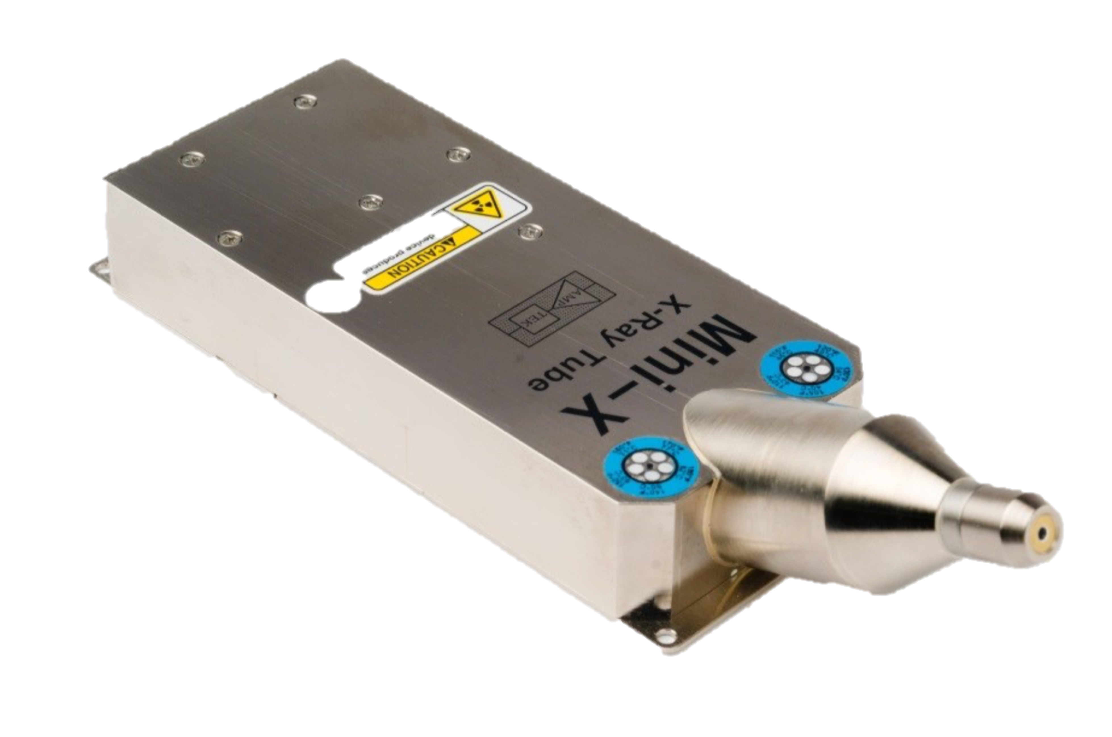
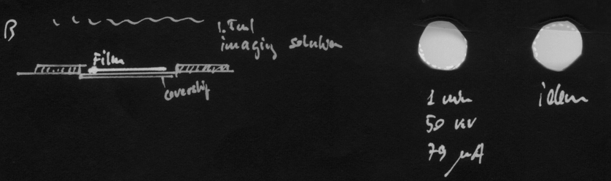
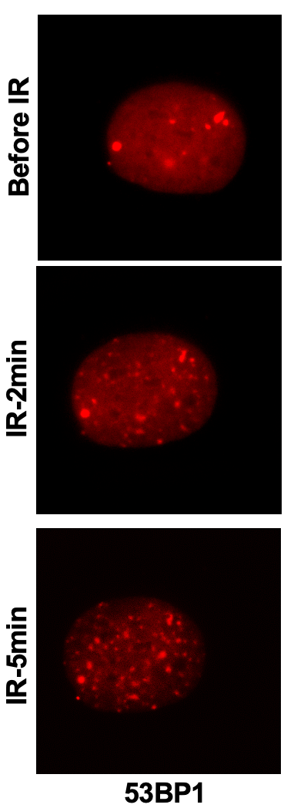
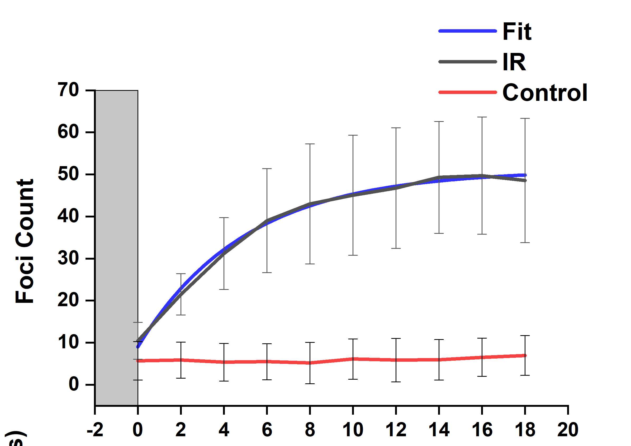
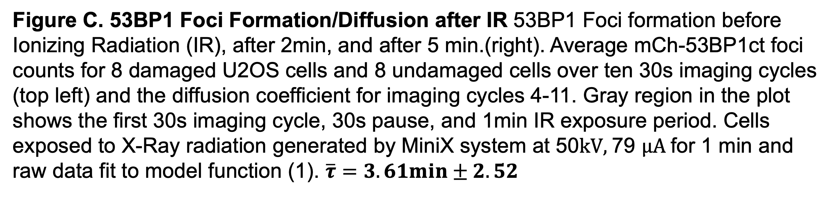
6 in.
IR
Before IR
U2OS PAGFP-H2A cells irradiated through a film for 1 min at 50 kV/79uA with the Mini-X apparatus (bottom left). Image acquisition is carried out as a sequence of 11 imaging cycles: 30s imaging at 3fps, 30s pause, 1min IR, 30s imaging, 90s pause, etc. giving one cycle before radiation and 10 cycles after radiation. Imaging method minimizes photo bleaching at high frame rates necessary for particle tracking and calculation of the diffusion coefficient.
Figure C. 53BP1 Foci Formation/Diffusion after IR 53BP1 Foci formation before Ionizing Radiation (IR), after 2min, and after 5 min.(right). Average mCh-53BP1ct foci counts for 8 damaged U2OS cells and 8 undamaged cells over ten 30s imaging cycles (top left) and the diffusion coefficient for imaging cycles 4-11. Gray region in the plot shows the first 30s imaging cycle, 30s pause, and 1min IR exposure period. Cells exposed to X-Ray radiation generated by MiniX system at 50$kV,$79 $μA$for 1 min and raw data fit to model function (1). $\overline{τ}=3.61min±2.52$

